Slide 1
Wiki3C: Exploiting Wikipedia for Context-aware Concept Categorization
Date: 2014/03/04
Author: Peng Jiang, Huiman Hou, Lijiang Chen, Shimin Chen, Conglei Yao, Chengkai Li, Min Wang
Source: WSDM’ 13
Advisor: Jia-Ling Koh
Speaker: Yi-Hsuan Yeh

Slide 2
Outline
Introduction
Wiki3C: Context-aware Concept Categorization
Experiments
Conclusion

Slide 3
Introduction
Wikipedia is a rich human-generated knowledge base containing over 21 million articles organized into millions of categories.
A concept in Wikipedia usually has many categories.
The categories bear different importance in different contexts.

Slide 4
Introduction cont’s

Slide 5
Introduction cont’s
Goal:
In this task, we are interested in ranking categories for a concept to determine which categories describe it better with respect to a particular textual context.

Slide 6
Wiki3C: context-aware concept categorization
Framework
Category Ranking
Child Article Selection
Split Article Selection
Compute Relatedness
Basic Model
Probabilistic Model

Slide 7
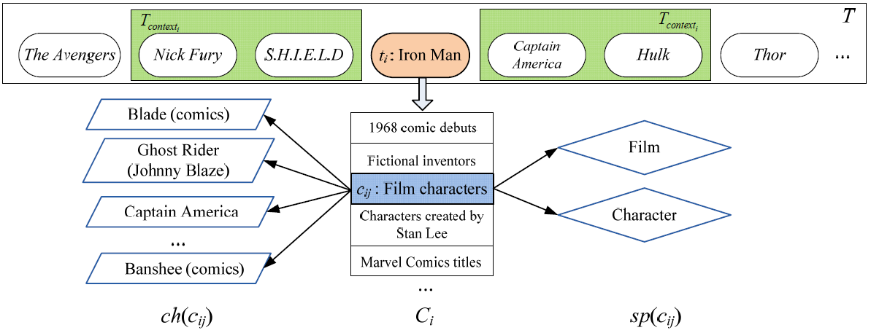
Framework
Categories
Child Article
Split Article

Slide 8
Category Ranking
Contextual concepts
Target concept
Child articles
Split articles
$t_{i} :target concept$
$t^{′}:contextual concept$
$c_{ij}:a category$

Slide 9
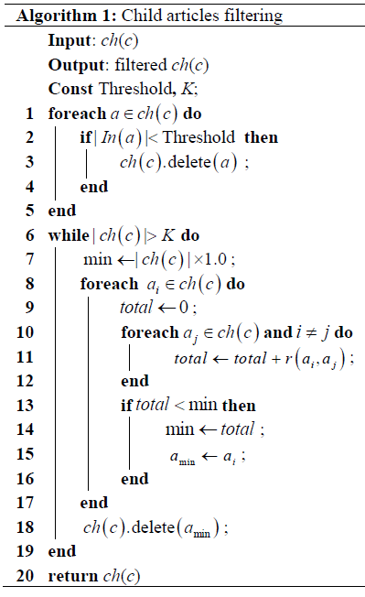
Child Article Selection
Use K articles with the highest relatedness with other articles in the category to represent the category.

Slide 10
Child Article Selection cont’s
Category: “Film characters”
Assume:
K: 2
Link threshold: 10
Blade (comic)
15
Ghost Rider
(Johnny Blaze)
8
Blade (comic) | 1.3
Captain America | 1.0
Banshee (comic) | 0.7
0.8
0.5
Captain America
23
0.2
Banshee (comic)
18
$$relatedness$$
$$the number of links it have$$

Slide 11
Child Article Selection cont’s
The relatedness between a concept and filtered child articles:
If the number of filtered child articles less then K
$t:a concept$
$t_{i}:a filtered child article$
$n^{′}:the numer of filtered child article$
$r\left(t, t^{′}\right):relatedness function$

Slide 12
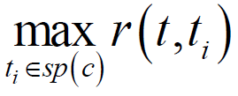
Split Article Selection
Select the split article with the maximum relatedness with concept to represent the category.
$t:a concept$
$t_{i}:a split article$
$r\left(t, t^{′}\right):relatedness function$

Slide 13
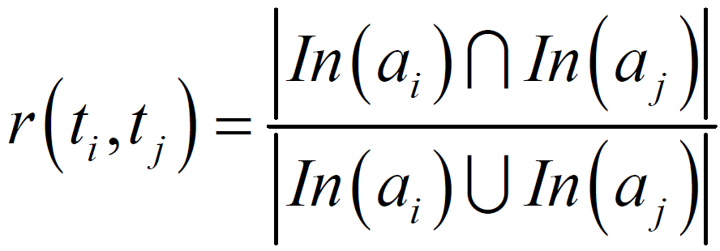
Compute Relatedness - Basic Model
The relatedness measuring is based on the comparison of link structures in Wikipedia articles.
Inlink (incoming link)
Outlink (outgoing link)

Slide 14
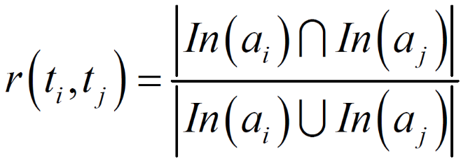
Compute Relatedness cont’s - Basic Model
${\text{A} \text{concept}\text{’}\text{s} \text{Wikipedia} \text{article} t}_{i}$
Inlink and outlink articles
$$a1, a3, a4, a8$$
$$r\left(t_{i}, t_{j}\right)=\frac{2}{8}$$
$$a filtered child article t_{j}$$
$$a2, a3, a5,a6, a8,a9$$

Slide 15
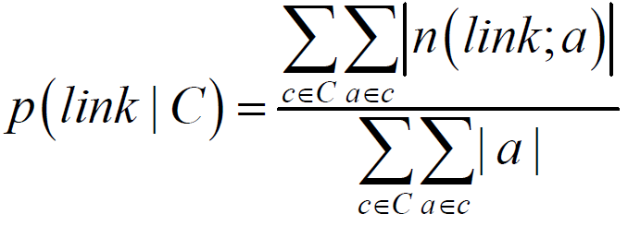
Compute Relatedness cont’s - Probabilistic Model
Represent a concept t as a probability distribution over links.
$t:a concept$
$\left|t\right|:the number of links in t$
$n\left(link;t\right):the numer of \text{link} appears in the t^{′}s article$
$μ:a parameter$
$C:the set categories that t belons to$

Slide 16
Compute Relatedness cont’s - Probabilistic Model
A concept t
Assume:
link: “US”
$μ$: 1000
Number of
all link / link ”US”
10 / 2
$$P\left(US|C\right)=\frac{20+30+10}{100+120+80}=\frac{1}{5}$$
t’s categories
$$c_{1}$$
$$n\left(US;t\right)=2$$
$$\left|t\right|=10$$
100 / 20
$$c_{2}$$
120 / 30
$$P\left(US|θ_{t}\right)=\frac{2+1000∗\frac{1}{5}}{10+1000}=\frac{1}{5}$$
$$c_{3}$$
80 / 10
$$C$$

Slide 17
Compute Relatedness cont’s - Probabilistic Model
KL-divergence
If $ti$ and $tj$ are the same concept, $D(θi || θj)$equals 0.
Use the negative KL-divergence to measure the relatedness.

Slide 18
Experiments
Data set
Experimental Results

Slide 19
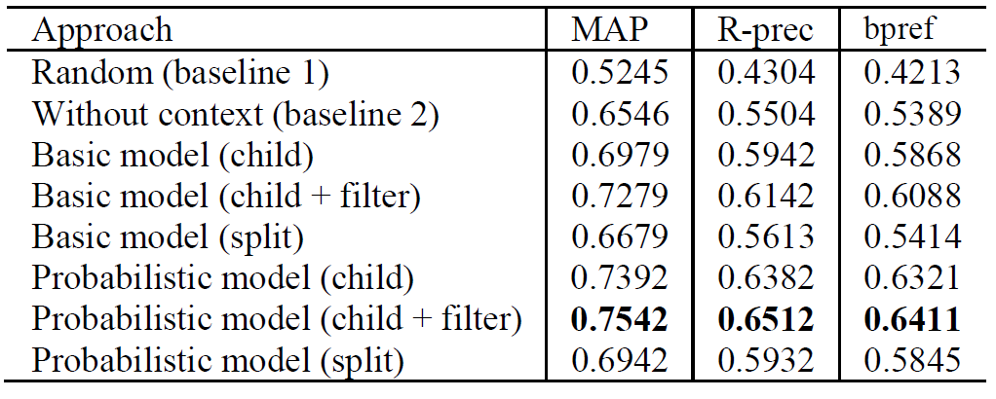
Data Set and Evaluation
3072 concepts
39044 categories
7780 relevant categories (human selected)
MAP, R-precision, bpref

Slide 20
Experimental Results

Slide 21
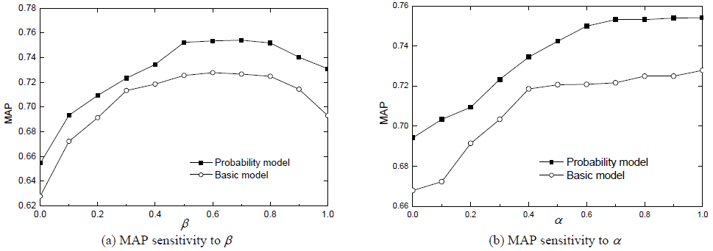
Experimental Results cont’s
0.7

Slide 22
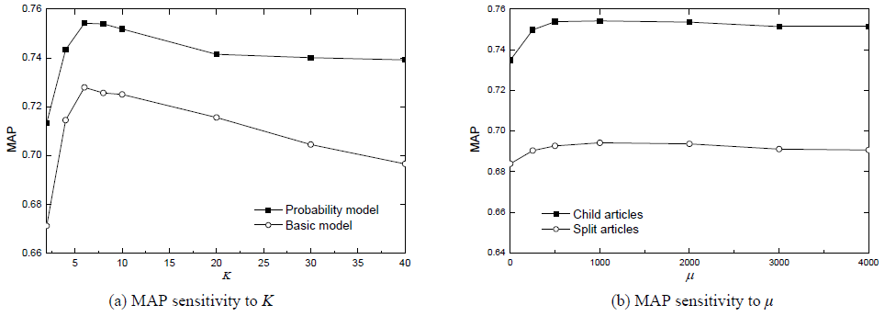
Experimental Results cont’s
8

Slide 23
conclusion

Slide 24
Conclusion
This paper proposes an unsupervised learning solution to the task of context-aware concept categorization, named Wiki3C.
Two strategies of article selection are chosen to represent category.
Use a probabilistic model to compute the semantic relatedness between concepts.
Experimental results prove the effectiveness of Wiki3C.

Slide 25
bpref
1 | A | R
2 | C | I
3 | B | R
4 | X | R
5 | K | R
6 | D | I
7 | N | R
8 | F | I
9 | G | I
10 | E | R
$$bpref=\frac{1}{10}\left[\left(1−\frac{0}{4}\right)+\left(1−\frac{1}{4}\right)+\left(1−\frac{1}{4}\right)+\left(1−\frac{1}{4}\right)+\left(1−\frac{1}{4}\right)+\left(1−\frac{2}{4}\right)+\left(1−\frac{2}{4}\right)+\left(1−\frac{3}{4}\right)+\left(1−\frac{4}{4}\right)+\left(1−\frac{4}{4}\right)\right]$$

